Slide 1
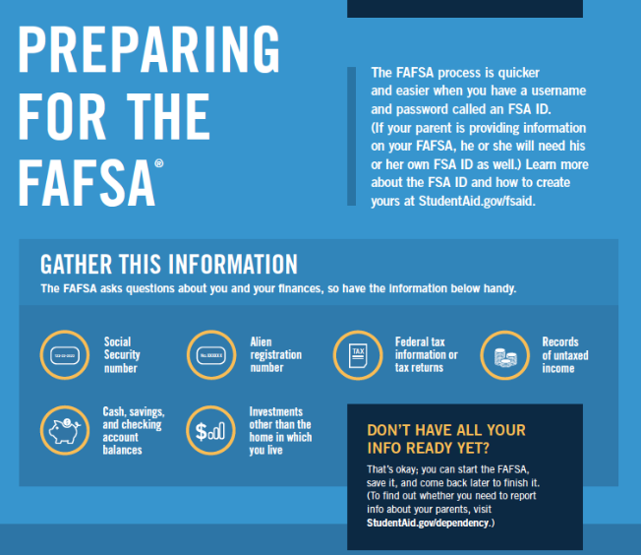


Come to a FAFSA Night at RHS!
We recommend that you come near the beginning of the session to ensure you have enough time to complete your 2026-27 FAFSA or ORSAA within the 2-hr window!
Thursday, October 9th | Thursday, October 23rd
Thursday, November 13th | Wednesday, December 10th
Wednesday, January 14th | Thursday, January 29th
Thursday, February 19th | Wednesday, March 11th
https://www.reynolds.k12.or.us/rhs/fafsaorsaa-nights-co2026
Contact Shannon Selby, College & Career Coordinator, with questions. | sselby@rsd7.net | x1077

