Slide 1
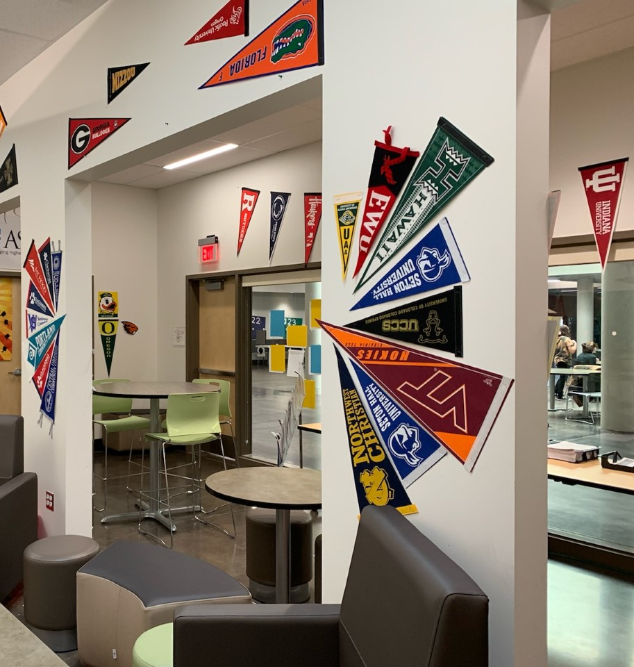
RHS Class of 2024 Welcome to the College & Career Center
It’s your senior year, and you should try to make every moment count. Before you know it, you’ll be crossing the stage at graduation. Plan to make this your best year ever!
During senior year, you might experience:
Hard work & challenges
Ups & downs
Disappointments & triumphs
Acceptance & rejection
But don’t give up…you CAN do it…and we’re here to help!

Slide 2
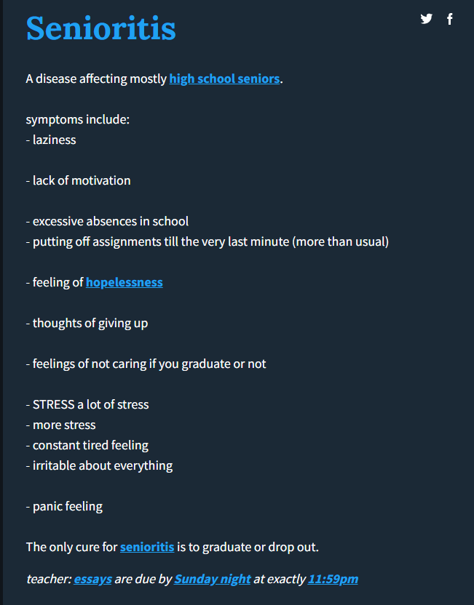
Senioritis can be a real thing… Don’t catch it!
sen·ior·i·tis
Noun HUMOROUS•US
a supposed affliction of students in their final year of high school or college, characterized by a decline in
motivation or performance.
My grades suffered due to senioritis, and the university
I was accepted to took away my admission offer.

Slide 3
What’s happening in the College & Career Center? How you can stay informed about events, activities & deadlines…
Check the RHS website https://reynolds.k12.or.us/rhs
Academics/News & Events (Activities, events & opportunities within next 2-3 months)
https://www.reynolds.k12.or.us/rhs/academics-0
Academics / College & Career Center pages
https://www.reynolds.k12.or.us/rhs/college-and-career-center-0
Check/join these Schoology Groups:
Class of 2024 Counseling Access Code: DCFC-ZWWP-53D7Z
College & Career Center Access Code: PR7X-GGBF-M58XN
OTHER WAYS TO STAY IN THE KNOW…
Raider News (Daily Announcements during P4/P8)
Senior teachers’ announcements (Synergy, Schoology)
Stop by during lunches or if you have a free period
Schedule an appointment
If you’re caught up with work in class, ask your teacher
for a pass to visit the CCC
Check the doors/windows for flyers/announcements
Email sselby@rsd7.net | Call 503.667.3186 x1077
Set reminders in your cell phone or use your planner to stay organized!

Slide 4
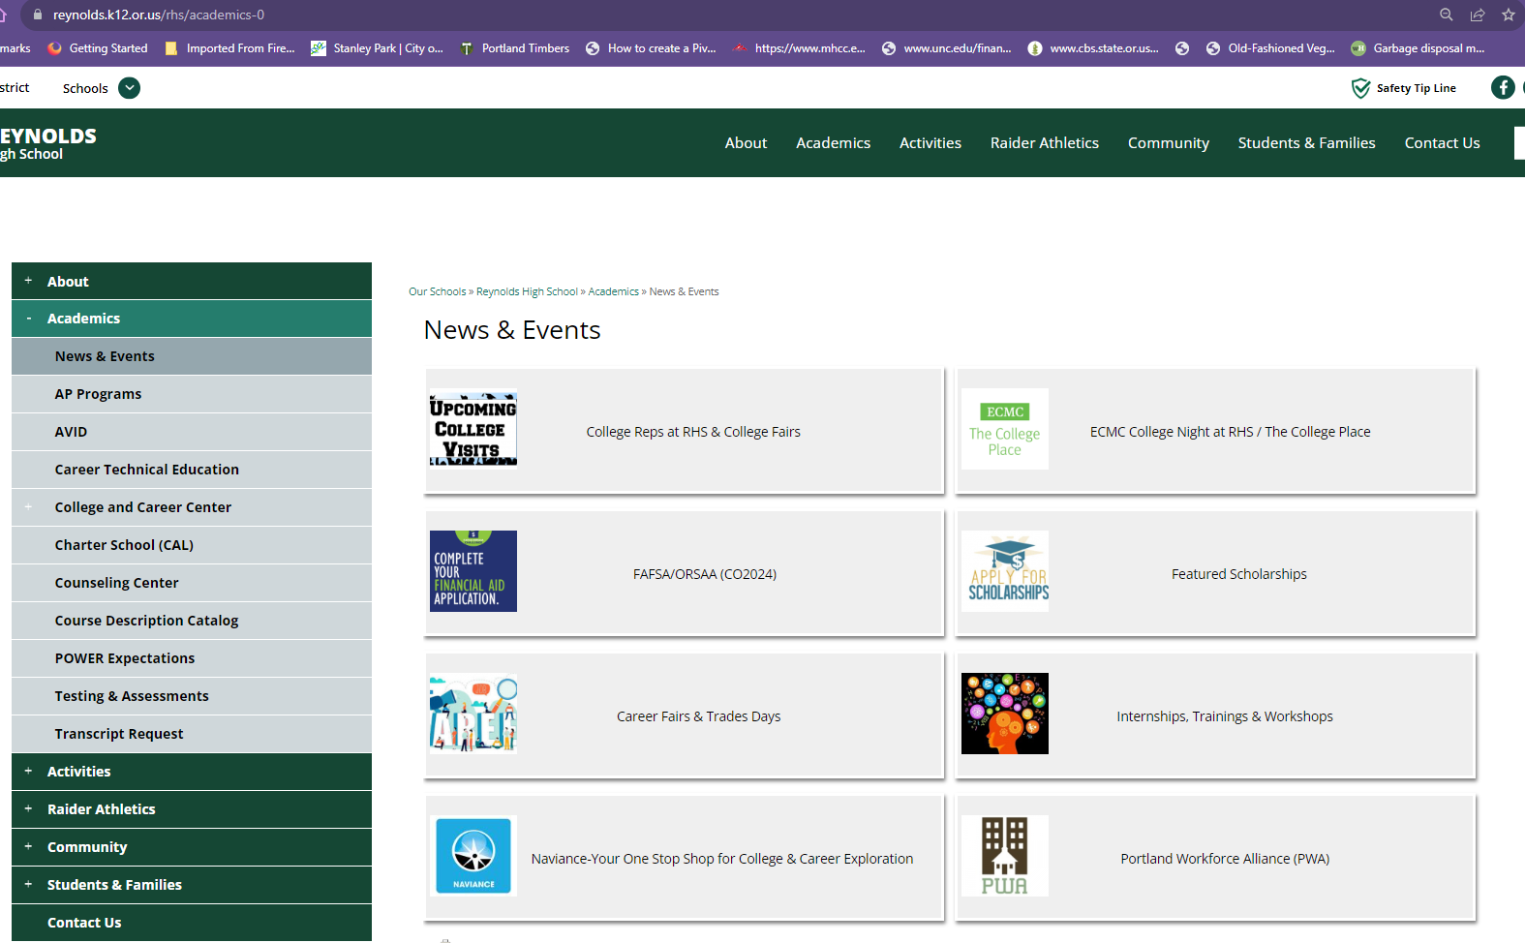

Slide 5
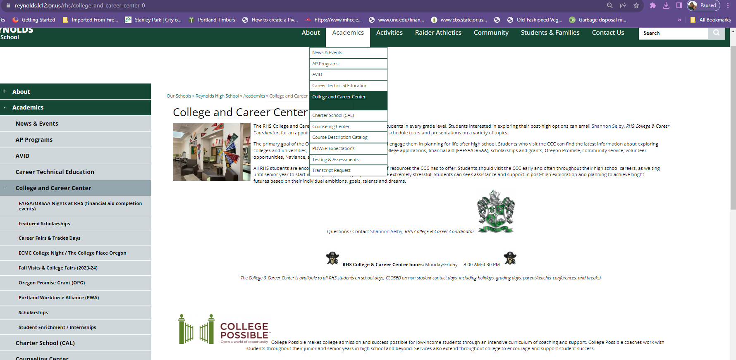
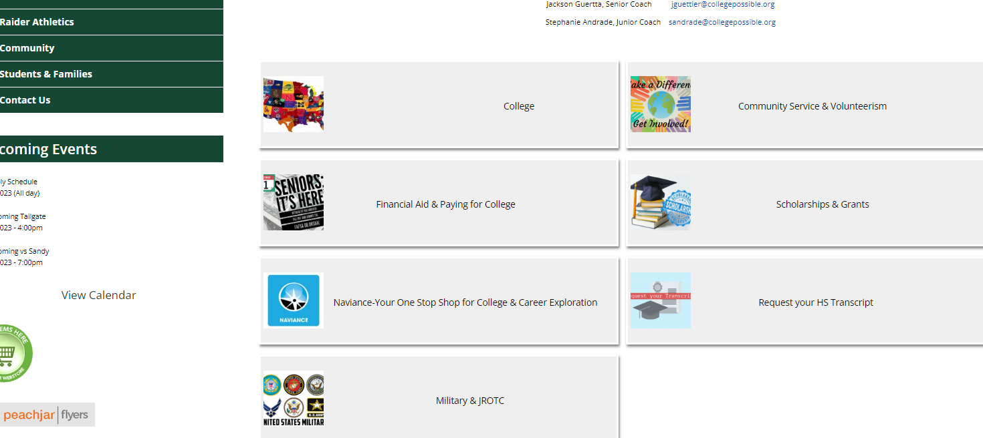

Slide 6
Community Service/Volunteering https://www.reynolds.k12.or.us/rhs/community-service-volunteerism
Besides feeling good about yourself and supporting others in your local communities, volunteering & community service activities also look great on college & scholarship applications.
DID YOU KNOW…you can earn the
silver “Extra Mile” cord to wear at graduation?
HOW DO I EARN THE SILVER EXTRA MILE CORD?
By performing and logging 250+ hours of qualified & verified community service activities between
GR 9-GR 12 (includes summer after 8th grade)
WHAT DO I NEED TO DO TO QUALIFY FOR THE SILVER CORD?
Fill out a COMMUNITY SERVICE LOG (or a resume that includes the same info) to track your volunteer hours
Keep track of your HOURS and COMMUNITY SERVICE LOGS throughout high school (keep them in a safe place where you won’t lose them!)
Turn in your COMMUNITY SERVICE LOGS/RESUMES
for verification in May of your senior year
Congratulations…you’ve EARNED the silver Extra Mile cord!
Thanks for your service…you make a difference!

Slide 7
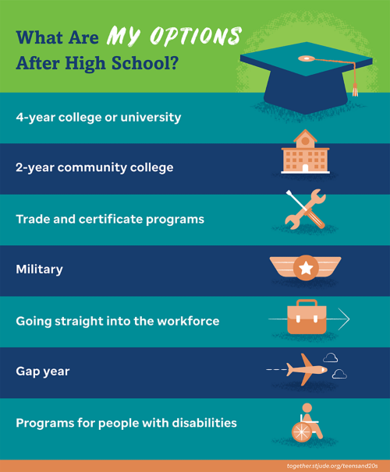
What are my Post-high options? Get in where you fit in!
You should be thinking about what you want your life after high school to look like…then making decisions and taking the steps needed to get there.
There are many post-high paths you can take…
Use Naviance to explore your college & career options
Make sure you and your counselor have discussed future plans so you’re on track to meet your post-high goals, whatever they might be.
Network with others, gather your resources, stay informed about opportunities & events related to your chosen career path(s), and explore the best options for you!
Become your best self-advocate
Ask for help when you need it

Slide 8
College isn’t the only path for everyone.
There are shorter-term training options with employment outcomes as the goal:
Certificate programs
Career Pathways, offered through local community colleges & on-the-job training
Explore the SKILLED TRADES…what can you do now to get started in an APPRENTICESHIP PROGRAM?
As an apprentice, you can get education, training, and pay while learning a trade…
PLUS the job outlook is excellent!

Slide 9
Use Naviance as a guide to plan for the future YOU want!
Use Naviance to explore colleges, universities, career pathways & careers. Build your college & career lists by clicking the “heart” icon next to the colleges & careers that interest you.
Naviance saves your work automatically.
LOG IN to Naviance from any device w/ an internet connection, including your Smart Phone!
Access Naviance through Clever; you can find it with your other school-based apps & programs (Look for the Naviance icon)
Visit https://student.naviance.com/reynoldshs
Choose “Student”
“Continue with Clever”
LOG IN using your school-issued username & password
https://www.reynolds.k12.or.us/rhs/naviance-your-one-stop-shop-college-career-exploration
Check the “What’s New” box on your Naviance Home Page
Admission counselors from universities schedule visits during lunches throughout the fall. The schedule is updated in real time. Plan to see the admission counselors from schools you want to know more about.
Admission requirements & application process
Programs & majors
Financial aid & scholarships
Clubs, activities, extracurriculars, student services
Campus life

Slide 10
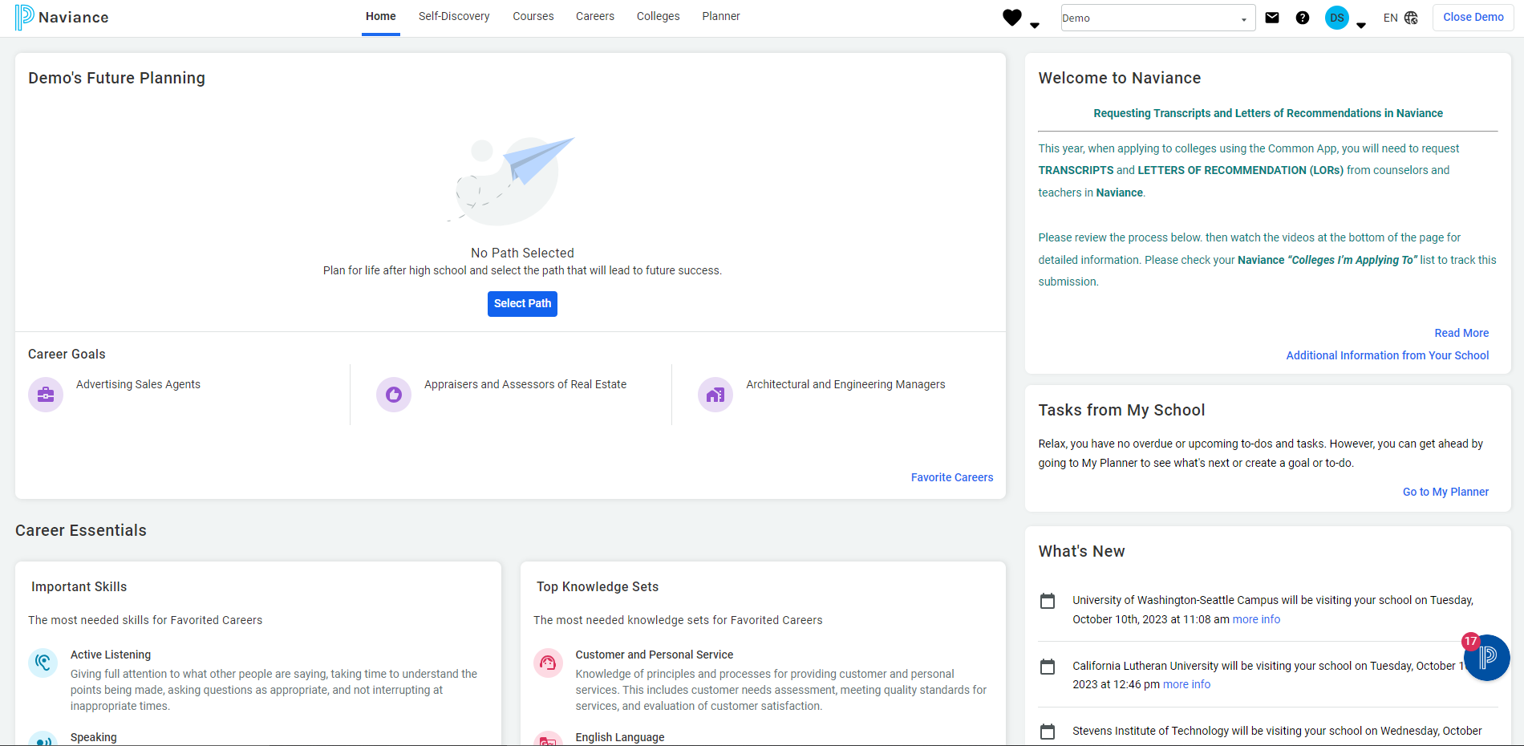
Take assessments, explore colleges, careers & career pathways, build your college & career lists to plan for a bright future!
This is your Naviance Home Page/ Dashboard
College Visit Schedule

Slide 11
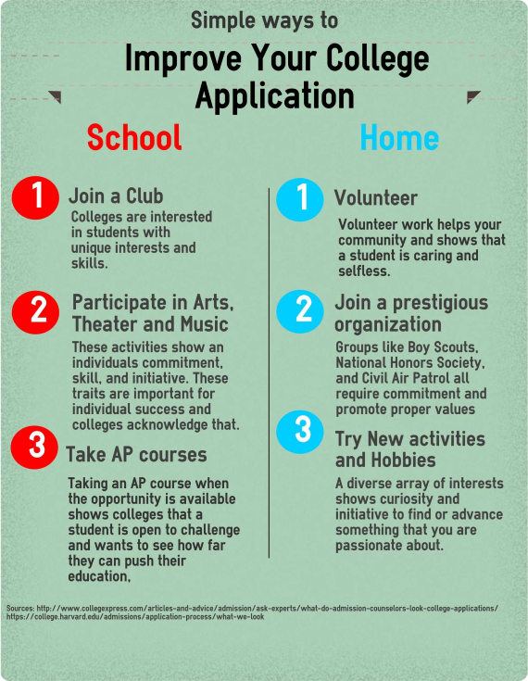
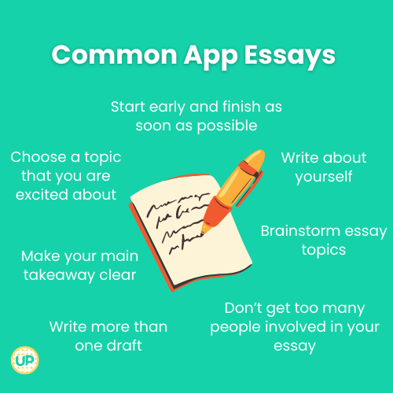
Common app… WHAT IS IT? Common App is a “universal” college application that hundreds of schools across the U.S. use for admission purposes WHY SHOULD I FILL IT OUT? APPLY for ADMISSION to hundreds of schools nationwide by completing ONE application! IMPORTANT: Not all schools participate w/ common app. To find out if the colleges you’re applying to participate, check: https://www.commonapp.org/explore If your school doesn’t participate with common app, you can complete the school’s individual admission application instead, which can be found on each school’s website. REQUIRES SHORT ESSAYS
What looks good on college applications?
Most colleges & universities have gone “test optional,” which means they no longer require you to submit ACT/SAT scores to make admission decisions.
Check your school’s admission requirements to find out if they require ACT or SAT test scores with your applications.

Slide 12
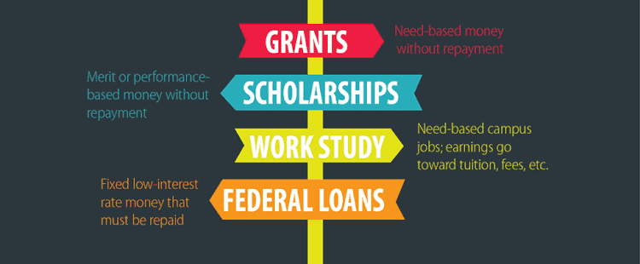
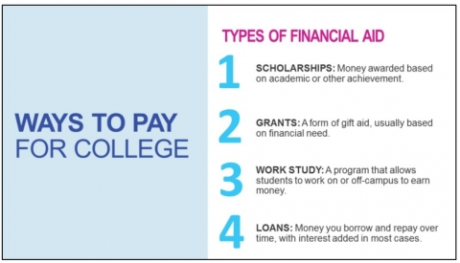
Paying for College &
other Post-High Training Programs

Slide 13
It’s (almost) FAFSA/ORSAA time!
Financial Aid applications (usually)
open on October 1st each year
EXCEPT FOR THIS YEAR…
The 2024-25 FAFSA/ORSAA won’t be OPEN
until December or January!
Applying for FAFSA or ORSAA is the FIRST STEP to apply for money to help pay for your college dreams.
Many scholarships & grants REQUIRE you to complete the FAFSA or ORSAA to qualify (including Oregon Promise)
DON’T WAIT! Do your FAFSA or ORSAA as soon as possible on or after October 1st (this year, once it’s available in December or January!)
You need to REAPPLY/UPDATE your FAFSA or ORSAA for the following school year on or after October 1st every year you’re in school.
HELP with your FAFSA or ORSAA is available…
Attend a FAFSA/ORSAA Night (Support Session) at RHS
Dates/times TBD starting in January 2024
FAFSA—Free Application for Federal Student Aid
ORSAA—Oregon Student Aid Application
Fill out the 2024-25 FAFSA or ORSAA

Slide 14
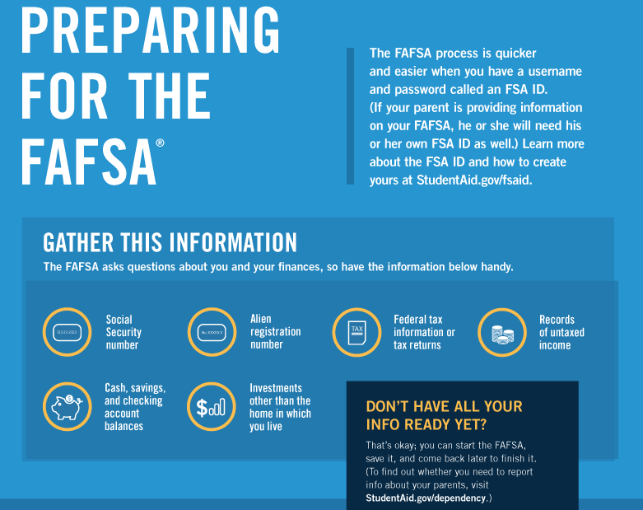
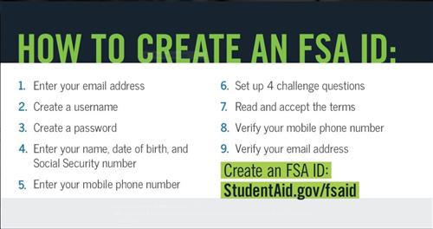
What you can do NOW to prepare for FAFSA/ORSAA…
You & at least one parent can
CREATE your FSA IDs now!
Work with your parent(s) to gather the documents you’ll need
2022 federal taxes are needed for the 2024-25 FAFSA or ORSAA.

Slide 15
Winning scholarships IS A GREAT WAY TO GET
free money To help FUND your post-high goals!
There are TONS of scholarship resources on
the scholarships page of the RHS website
Looking through all the scholarships to find which ones you’re eligible is the hardest part!
APPLY for as many scholarships as you’re eligible for
SUBMIT YOUR BEST WORK for a greater chance of being awarded!
Keep your eyes & ears open to learn about new scholarship opportunities; APPLY for scholarships throughout the year, and even once you’re in college!
STAY ORGANIZED! Keep track of DUE DATES & DEADLINES in your planner or the calendar on your Smart Phone.
Follow all instructions carefully & submit complete applications. ALWAYS submit applications by the deadline…NO EXCEPTIONS!
SCHOLARSHIPS, SCHOLARSHIPS, EVERYWHERE!
There’s a 100% chance you WON’T get FREE MONEY for school if you don’t APPLY!!!
Main Scholarships page
https://www.reynolds.k12.or.us/rhs/scholarships
Featured Scholarships
https://www.reynolds.k12.or.us/rhs/featured-scholarships

Slide 16
College Possible is still accepting applications…
Ask how you can apply for College Possible today!
College Possible is a program that helps 11th & 12th GR students get through all the steps it takes to prepare, apply, and get accepted to college.
The goal of College Possible is to help first-generation college students, low-income, or under-represented minorities realize the college dream!
College Possible is a FREE PROGRAM, but you have to apply & interview to participate.
College Possible coaches work with students throughout their junior and senior years in high school, then follow you throughout your entire college experience to help ensure a smooth transition from high school to college, and foster student success while you’re there.
Coaches are in the College & Career Center
Monday-Thursday | 9 AM-5 PM
(working off-site on Fridays)
Jackson Guettler, 12th GR coach
JacksonGuettler@partner.rsd7.net
Stephanie Andrade, 11th GR coach
StephanieAndrade@partner.rsd7.net

Slide 17
FIELD TRIPS
Trades Day: A Day for Career Exploration
An interactive, hands-on construction trades career exploration fair
Explore careers in construction, design, sub-contracting, heavy equipment, engineering, and other skilled trades.
Oregon Convention Center | Tue, Nov. 7th | 9:15 AM-12:45 PM
Pick up PERMISSION SLIPS before you leave here today!
INTERNSHIP OPPORTUNITIES
ACE Mentor Program
Mentorships/internships for students (GR 11/12) interested in career pathways in Architecture, Construction & Engineering
Applications now OPEN - DUE by Monday, November 13th
Tappin’Roots – PAID Environmental internships for Black-identifying students
INFO SESSION IN CCC DURING LUNCHES ON THURSDAY, OCTOBER 12th
COLLEGE VISITS THIS WEEK
Wed, Oct. 11th Stevens Institute of Technology 1st lunch
Pacific University 2nd lunch
Don’t forget to check NAVIANCE ("What's New”) to see when the schools you want to know more about are visiting RHS during lunches.

Slide 18
Join us for COLLEGE NIGHT at RHS on Thursday, October 26th
at 6 PM in the MPR!
At ECMC College Night, students and families will hear a live presentation (ENG & SP) on accessing college, including:
How going to college can change your life
Choosing the right college/finding your college fit
Understanding the financial aid process
Scholarship searches and scams
Plus, one lucky student who attends the event will win a $1,000 scholarship to help pay for college!
Random drawing at end of event
Must be present to win
Winner will receive a certificate at the event; the certificate will have instructions on how to claim the prize money
https://www.reynolds.k12.or.us/rhs/ecmc-college-night-th-1026-college-place-oregon
Questions? Contact Shannon Selby, College & Career Coordinator | sselby@rsd7.net | x1077

Slide 19
Still need help? I’m here for you…just ask!
Contact Shannon Selby
College & Career Coordinator
sselby@rsd7.net | 503.667.3186 x1077

