Slide 1
Employees
Financial Services Department
1204 NE 201st Avenue, Fairview, OR 97024
Phone: 503-661-7200 Fax: 503-667-6932 www.reynolds.k12.or.us
How to enter time in Timeclock plus, View status of submitted entries, and download time entry reports

Slide 2
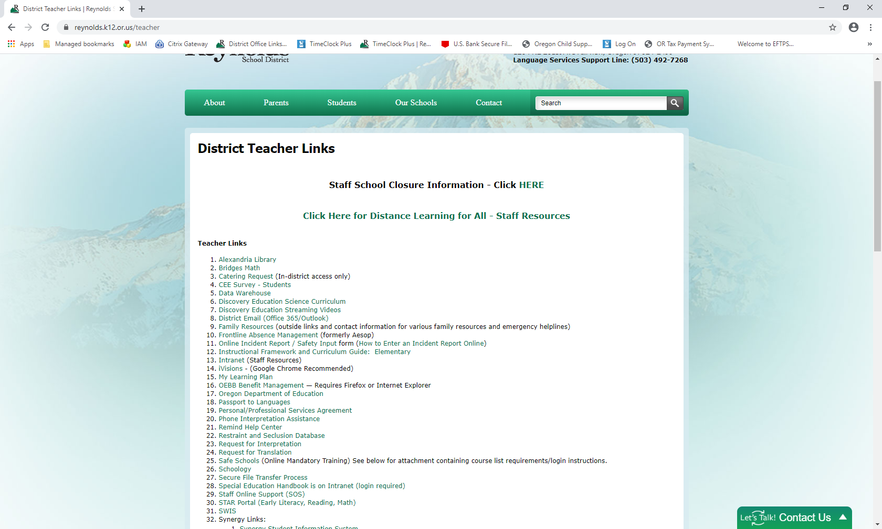
ways to access tcp WWW.REYNOLDS.K12.OR.US/TEACHER #35 Www.Reynolds.k12.or.us/office #28

Slide 3
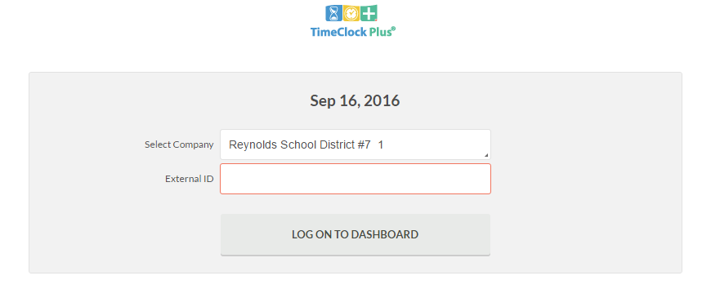
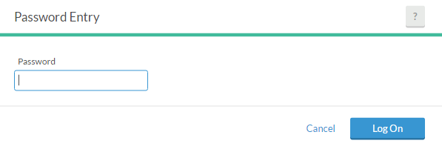
Timeclock Plus Login Page
https://rs3.tcplusondemand.com/app/webclock/#/EmployeeLogOn/92594
External ID: Enter the same login as your RSD computer/email login.
For temps who do not use an RSD computer/email login, enter your first initial and last name (ex: mjordan)
Password: Your password is the same as your RSD computer/email password.
Temps: Default password is either PEID plus two zeroes or just PEID (example: 99999900 or 999999)
If you are having issues logging in, contact Payroll at TimeClockPlus@rsd7.net
Although change PIN is a function shown on the website, it is disabled and you must contact TimeClockPlus@rsd7.net for help.

Slide 4
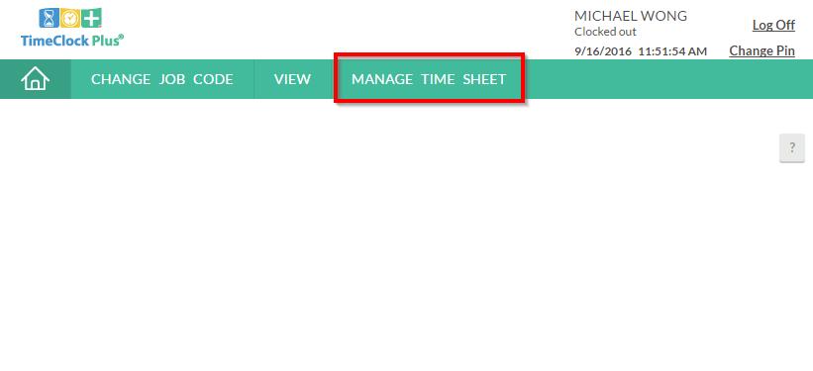
Timeclock plus Dash board
Employee Name and Date
Click the Manage time sheet tab to navigate to the time entry page

Slide 5
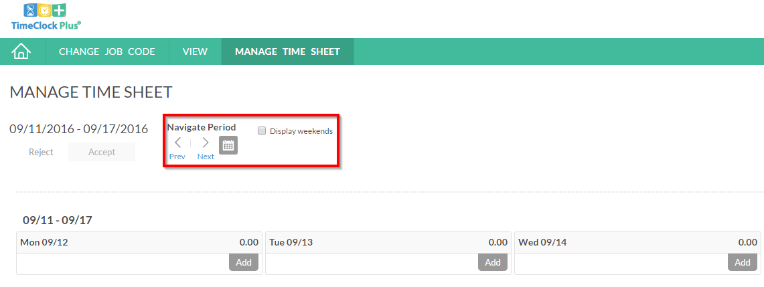
How to enter time
Navigate to the correct week
PLEASE NOTE YOU WILL ONLY BE ABLE TO NAVIGATE WITHIN THE CURRENT MONTH (FOR PRIOR MONTH ENTRIES SEE YOUR BUILDING ADMINISTRATOR OR SECRETARY)

Slide 6
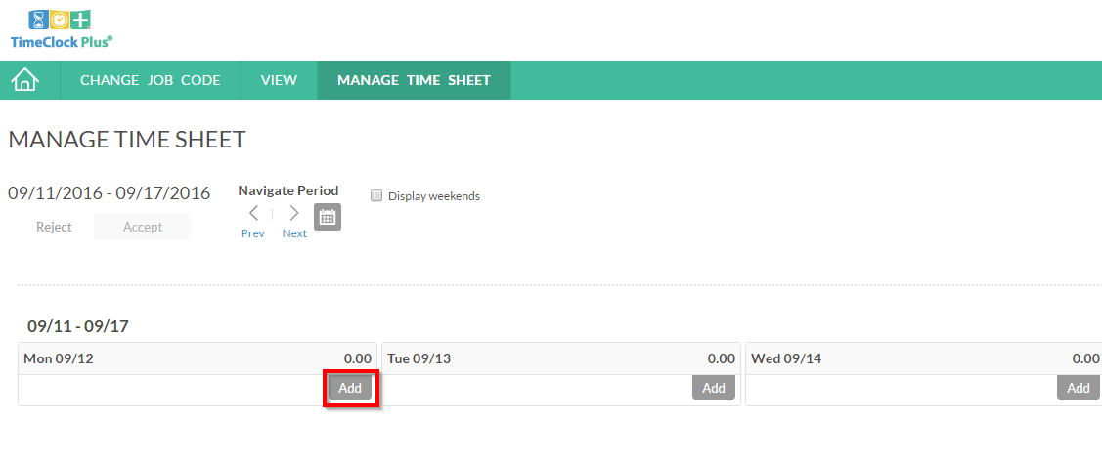
How to enter time
Click the add button to expand desired day

Slide 7
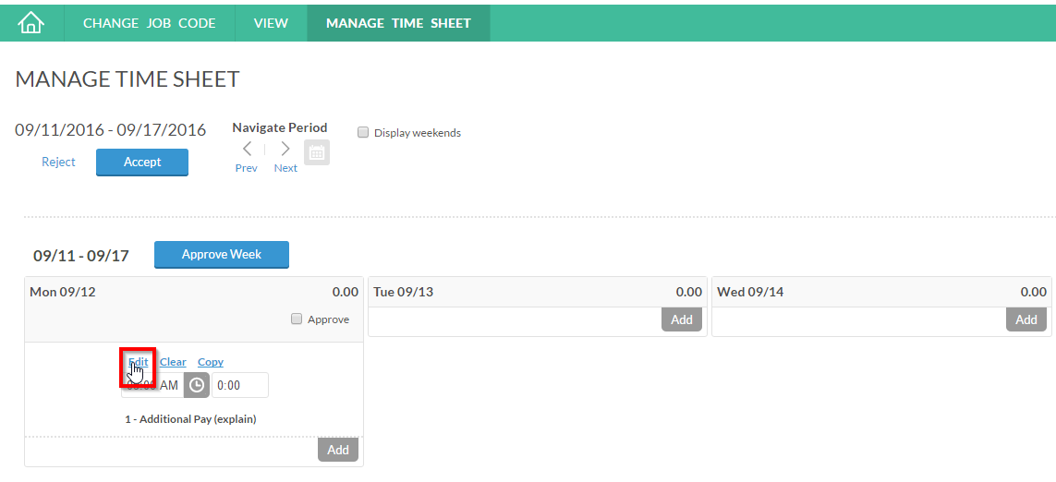
How to enter time
Click on “edit” to open the Edit Segment window

Slide 8
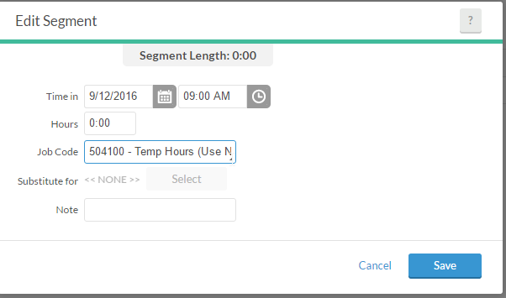
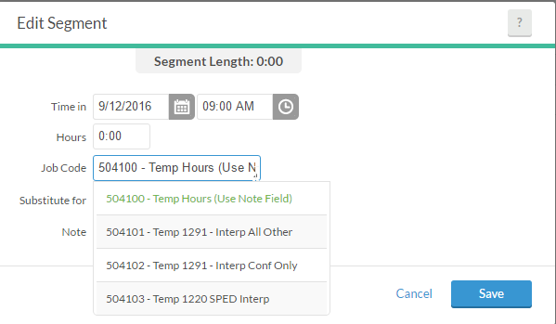
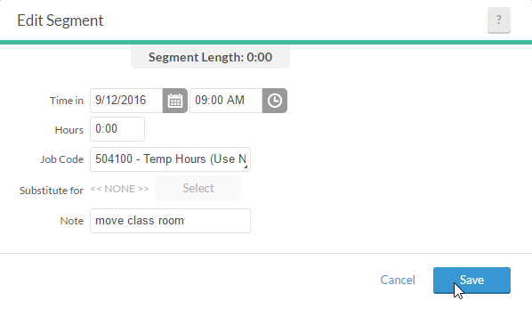
How to enter time
Step 3. Enter time, number of hours, pick job code from drop-down, type reason in the note field, and click save.
ENTER HOURS,
PICK JOB CODE,
ADD A NOTE

Slide 9
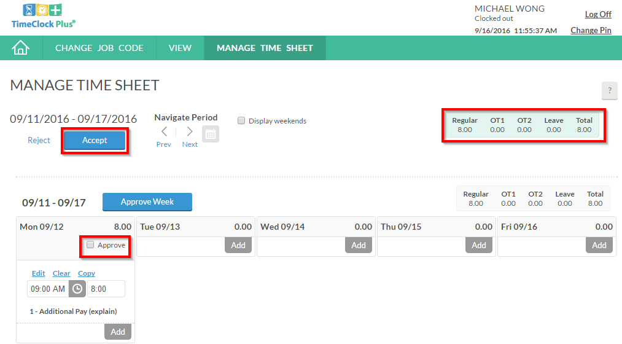
How to enter time
1. Click check boxes to approve entries by day 2. then click the accept button to save changes. USE THE APPROVE WEEK BUTTON TO APPROVE ALL.
Summary of Time Entries
2
1

Slide 10
How to Check the status of a submitted time entry
WE ENCOURAGE YOU TO DOUBLE CHECK YOUR ENTRIES TO ENSURE THAT YOU ARE PAID CORRECTLY ☺
For questions, please contact TimeClockPlus@rsd7.net

Slide 11
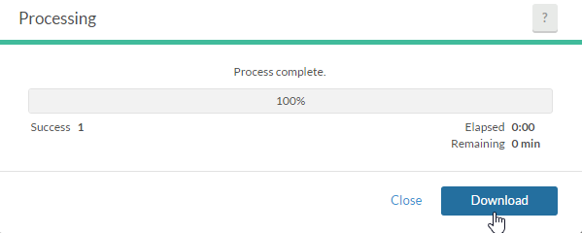
How to download time entry report
Employee can download a report of their time entries

Slide 12
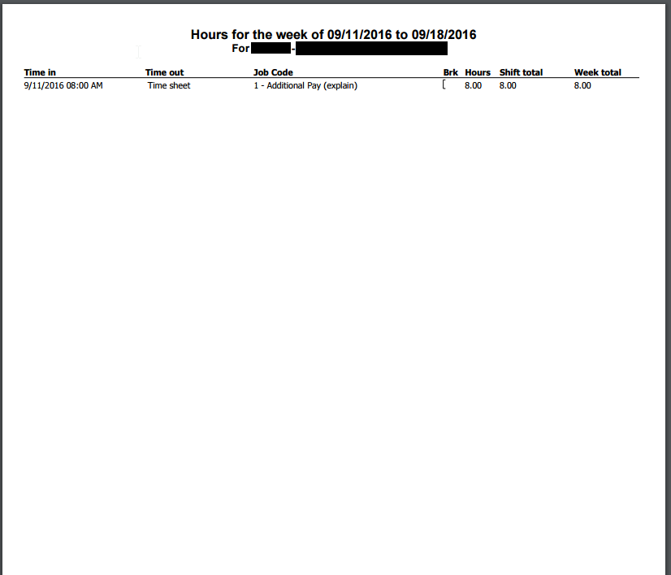
time entry report
PEID and name of employee

